Slide 1
Deformation model functional model project team report Chris Crook, Kevin Kelly – convenors
Note: this work is being conducted in association with the International Association of Geodesy (IAG) working group IAG WG 1.3.1 on "Time-dependent transformations between reference frames in deforming regions".
Working with associated project Gridded Geodetic Data Exchange Format (GGXF) project for transport layer.

Slide 2
Why?
Most accurate and accessible positioning system is global reference frame based on GNSS
Everything is moving in terms of global reference frame!
Deformation model estimates movement of "stationary" objects on the surface of earth (eg buildings, buried services...)
Used in coordinate transformations to align data observed at different times
No standard format for encoding deformation models

Slide 3
Working definition:
A deformation model is a model of the displacement of the earth’s surface within a defined spatial and temporal extent. It predicts the location of a point fixed to the surface at any time within the temporal extent in terms of an accessible coordinate system. The position of the point is represented as a displacement from a reference position for that point.

Slide 4
User survey
Responses from 27 countries on 5 continents
Mainly from geodetic/mapping agencies – potential producers of deformation models
9 have models in use, 10 in development, 4 planned
13 are velocity models, but 7 include some coseismic or postseismic models
Production systems mainly using custom formats and custom software. Recently some models implemented into PROJ coordinate system conversion library

Slide 5
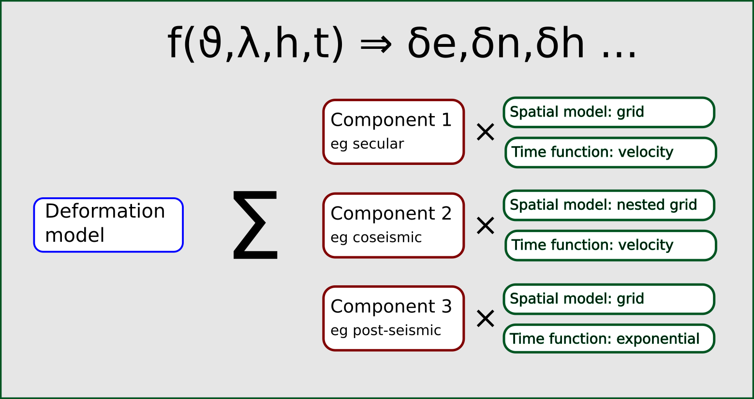
"Straw man" functional model specification
Focus of the project team for the last 6 months
Raised 23 technical github issues for discussion – resolved 18
Example technical issues
displacement model?
triangulated spatial models?
choice of time functions
handling of discontinuity
representation of uncertainty
no-data values

Slide 6
Want more information?
The work of the project team is documented in github at:
https://github.com/opengeospatial/CRS-Deformation-Models
The main discussion points are recorded as github issues.

